Slide 1
ZZULI ABET Workshop
Assessment and Continuous Improvement
Oakland University
July 15-19, 2019
Michael Latcha, PhD
Source: https://www.abet.org/accreditation/accreditation-criteria/criteria-for-accrediting-engineering-programs-2019-2020/

Slide 2
Tentative outline
Monday: ABET Accreditation Overview
  ABET accreditation requirements
  Assessment / evaluation / feedback process
Wednesday: ABET Criteria 1-4
  Students
  Program Educational Objectives
  Student Outcomes
  Continuous Improvement
Thursday: ABET Criteria 5-8
  Curriculum
  Faculty
  Facilities
  Institutional Support
Friday: OU SECS Assessment and Continuous Improvement

Slide 3
ABET Accreditation Overview
“[ABET] criteria are intended to foster the systematic pursuit of improvement in the quality of engineering education that satisfies the needs of its constituencies in a dynamic and competitive environment. It is the responsibility of the institution seeking accreditation of an engineering program to demonstrate clearly that the program meets the… criteria.”

Slide 4
ABET Accreditation Overview (1)
ABET Accreditation consists of
Setting measurable goals (outcomes) for students, in consultation with constituents
  Within the curriculum
  After graduation
Measuring and evaluating student progress with respect to the outcomes
  Within the curriculum
  After graduation

Slide 5
ABET Accreditation Overview (2)
ABET Accreditation consists of
Continually assessing, evaluating and adjusting to improve the
  Academic curriculum
  Goals, objectives and outcomes of the curriculum
  Assessment and evaluation process
Appropriate personnel and support
  Faculty
  Facilities
  Institutional support

Slide 6
ABET Accreditation Overview (3)
Exercises
List the constituents of your engineering program
List the skills you expect your engineering graduates to demonstrate in the workplace (Program Educational Objectives)
List the skills you expect your engineering students to have on graduation (Student Outcomes)

Slide 7
Continuous Improvement Process (1)
A continuous improvement process involves both assessment and evaluation
ABET DEFINITION: Assessment – Assessment is one or more processes that identify, collect, and prepare data to evaluate the attainment of student outcomes. Effective assessment uses relevant direct, indirect, quantitative and qualitative measures as appropriate to the outcome being measured. Appropriate sampling methods may be used as part of an assessment process.
ABET DEFINITION: Evaluation – Evaluation is one or more processes for interpreting the data and evidence accumulated through assessment processes. Evaluation determines the extent to which student outcomes are being attained. Evaluation results in decisions and actions regarding program improvement.

Slide 8
Continuous Improvement Process (2)
Assessment requires:
A desired student outcome - a goal - that can be measured
  The more specific an objective, the easier it is to demonstrate and measure
  Student outcomes should be expressed in action words
  Exercise: revise student outcomes
The appropriate measurements of the student outcomes
  Direct
  Indirect
  Quantitative
  Qualitative
Appropriate sampling
Exercise: List possible ways to assess the student outcomes

Slide 9
Continuous Improvement Process (3)
Evaluation requires:
A process for examining and interpreting the Student Outcome and Program Educational Objective measurements
A feedback process to continually improve
  The Student Outcome and Program Educational Objective measurement results
  The Student Outcome and Program Educational Objective measurements
  The Student Outcome and Program Educational Objective statements
Exercise: List ways to evaluate Student Outcomes and Program Educational Objectives, and feedback

Slide 10
ABET Criterion 1: Students
Student performance must be evaluated.
Student progress must be monitored to foster success in attaining student outcomes, thereby enabling graduates to attain program educational objectives.
Students must be advised regarding curriculum and career matters.
The program must have and enforce policies for accepting both new and transfer students, awarding appropriate academic credit for courses taken at other institutions, and awarding appropriate academic credit for work in lieu of courses taken at the institution.
The program must have and enforce procedures to ensure and document that students who graduate meet all graduation requirements.

Slide 11
ABET Criterion 2: Program Educational Objectives
ABET DEFINITION: Program Educational Objectives – Program educational objectives are broad statements that describe what graduates are expected to attain within a few years after graduation. Program educational objectives are based on the needs of the program’s constituencies.
The program must have published program educational objectives that are consistent with the mission of the institution, the needs of the program’s various constituencies, and these criteria.
There must be a documented, systematically utilized, and effective process, involving program constituencies, for the periodic review of these program educational objectives that ensures they remain consistent with the institutional mission, the program’s constituents’ needs, and these criteria.

Slide 12
ABET Criterion 3: Student Outcomes (1)
ABET Criterion 3. Student Outcomes
ABET DEFINITION: Student Outcomes – Student outcomes describe what students are expected to know and be able to do by the time of graduation. These relate to the knowledge, skills, and behaviors that students acquire as they progress through the program.
The program must have documented student outcomes that support the program educational objectives. Attainment of these outcomes prepares graduates to enter the professional practice of engineering. Student outcomes are outcomes (1) through (7), plus any additional outcomes that may be articulated by the program.

Slide 13
ABET Criterion 3: Student Outcomes (2)
(1) an ability to identify, formulate, and solve complex engineering problems by applying principles of engineering, science, and mathematics
ABET DEFINITION: Complex Engineering Problems – Complex engineering problems include one or more of the following characteristics: involving wide-ranging or conflicting technical issues, having no obvious solution, addressing problems not encompassed by current standards and codes, involving diverse groups of stakeholders, including many component parts or sub-problems, involving multiple disciplines, or having significant consequences in a range of contexts.

Slide 14
ABET Criterion 3: Student Outcomes (3)
(2) an ability to apply engineering design to produce solutions that meet specified needs with consideration of public health, safety, and welfare, as well as global, cultural, social, environmental, and economic factors
ABET DEFINITION: Engineering Design – Engineering design is a process of devising a system, component, or process to meet desired needs and specifications within constraints. It is an iterative, creative, decision-making process in which the basic sciences, mathematics, and engineering sciences are applied to convert resources into solutions. Engineering design involves identifying opportunities, developing requirements, performing analysis and synthesis, generating multiple solutions, evaluating solutions against requirements, considering risks, and making trade- offs, for the purpose of obtaining a high-quality solution under the given circumstances. For illustrative purposes only, examples of possible constraints include accessibility, aesthetics, codes, constructability, cost, ergonomics, extensibility, functionality, interoperability, legal considerations, maintainability, manufacturability, marketability, policy, regulations, schedule, standards, sustainability, or usability.

Slide 15
ABET Criterion 3: Student Outcomes (4)
(3) an ability to communicate effectively with a range of audiences
(4) an ability to recognize ethical and professional responsibilities in engineering situations and make informed judgments, which must consider the impact of engineering solutions in global, economic, environmental, and societal contexts

Slide 16
ABET Criterion 3: Student Outcomes (5)
(5) an ability to function effectively on a team whose members together provide leadership, create a collaborative and inclusive environment, establish goals, plan tasks, and meet objectives
ABET DEFINITION: Team – A team consists of more than one person working toward a common goal and should include individuals of diverse backgrounds, skills, or perspectives.

Slide 17
ABET Criterion 3: Student Outcomes (6)
(6) an ability to develop and conduct appropriate experimentation, analyze and interpret data, and use engineering judgment to draw conclusions
(7) an ability to acquire and apply new knowledge as needed, using appropriate learning strategies.

Slide 18
Criterion 4: Continuous Improvement
The program must regularly use appropriate, documented processes for assessing and evaluating the extent to which the student outcomes are being attained.
The results of these evaluations must be systematically utilized as input for the continuous improvement of the program.
Other available information may also be used to assist in the continuous improvement of the program.

Slide 19
Criterion 5: Curriculum (1)
The curriculum requirements specify subject areas appropriate to engineering but do not prescribe specific courses.
The program curriculum must provide adequate content for each area, consistent with the student outcomes and program educational objectives, to ensure that students are prepared to enter the practice of engineering. The curriculum must include:

Slide 20
Criterion 5: Curriculum (2)
(a) a minimum of 30 semester credit hours (or equivalent) of a combination of college-level mathematics and basic sciences with experimental experience appropriate to the program.
ABET DEFINITION: College-Level Mathematics – College-level mathematics consists of mathematics that requires a degree of mathematical sophistication at least equivalent to that of introductory calculus. For illustrative purposes, some examples of college-level mathematics include calculus, differential equations, probability, statistics, linear algebra, and discrete mathematics.
ABET DEFINITION: Basic Science – Basic sciences are disciplines focused on knowledge or understanding of the fundamental aspects of natural phenomena. Basic sciences consist of chemistry and physics and other natural sciences including life, earth, and space sciences.

Slide 21
Criterion 5: Curriculum (3)
(b) a minimum of 45 semester credit hours (or equivalent) of engineering topics appropriate to the program, consisting of engineering and computer sciences and engineering design, and utilizing modern engineering tools.
ABET DEFINITION: Engineering Science – Engineering sciences are based on mathematics and basic sciences but carry knowledge further toward creative application needed to solve engineering problems. These studies provide a bridge between mathematics and basic sciences on the one hand and engineering practice on the other.

Slide 22
Criterion 5: Curriculum (4)
(c) a broad education component that complements the technical content of the curriculum and is consistent with the program educational objectives.
(d) a culminating major engineering design experience that 1) incorporates appropriate engineering standards and multiple constraints, and 2) is based on the knowledge and skills acquired in earlier course work.

Slide 23
Criterion 6: Faculty (1)
The program must demonstrate that the faculty members are of sufficient number and they have the competencies to cover all of the curricular areas of the program.
There must be sufficient faculty to accommodate adequate levels of student-faculty interaction, student advising and counseling, university service activities, professional development, and interactions with industrial and professional practitioners, as well as employers of students.

Slide 24
Criterion 6: Faculty (2)
The program faculty must have appropriate qualifications and must have and demonstrate sufficient authority to ensure the proper guidance of the program and to develop and implement processes for the evaluation, assessment, and continuing improvement of the program.
The overall competence of the faculty may be judged by such factors as education, diversity of backgrounds, engineering experience, teaching effectiveness and experience, ability to communicate, enthusiasm for developing more effective programs, level of scholarship, participation in professional societies, and licensure as Professional Engineers.

Slide 25
Criterion 7: Facilities
Classrooms, offices, laboratories, and associated equipment must be adequate to support attainment of the student outcomes and to provide an atmosphere conducive to learning.
Modern tools, equipment, computing resources, and laboratories appropriate to the program must be available, accessible, and systematically maintained and upgraded to enable students to attain the student outcomes and to support program needs.
Students must be provided appropriate guidance regarding the use of the tools, equipment, computing resources, and laboratories available to the program.
The library services and the computing and information infrastructure must be adequate to support the scholarly and professional activities of the students and faculty.

Slide 26
Criterion 8: Institutional Support
Institutional support and leadership must be adequate to ensure the quality and continuity of the program.
Resources including institutional services, financial support, and staff (both administrative and technical) provided to the program must be adequate to meet program needs.
The resources available to the program must be sufficient to attract, retain, and provide for the continued professional development of a qualified faculty.
The resources available to the program must be sufficient to acquire, maintain, and operate infrastructures, facilities, and equipment appropriate for the program, and to provide an environment in which student outcomes can be attained.

Slide 27
OU SECS Assessment and Continuous Improvement
Assessment question: Do SECS students demonstrate achievement of the student outcomes before graduation?

Slide 28
OU SECS Assessment and Continuous Improvement
Features of the SECS Assessment and Continuous Improvement Process
Each course has Course Objectives, mapped to ABET Student Outcomes
Key Courses – subset of courses for External Assessment
External Assessment of ABET Student Outcomes in Key Courses (direct measure)
Student End-Of-Course Evaluations – based on Course Objectives
Faculty End-Of-Course Summaries – Faculty input
Senior Exit Surveys
Alumni Input
Employer Input

Slide 29
OU SECS Assessment and Continuous Improvement
Each SECS course has a set of course objectives that are specific applications of the ABET student outcomes to the topics in that course.
Each semester, all the students in every SECS course evaluate the course based on the course objectives.
Course objectives are mapped to the student outcomes across the curriculum, and each student outcome that is addressed in a course is rated as being introduced, reinforced or achieved.

Slide 30
OU SECS Assessment and Continuous Improvement
Key courses are a set of courses in the program that are:
required of all students in the program,
not able to be transferred from other institutions and
selected so that evidence of the achievement of all student outcomes is possible through the entire set of key courses.
Key courses normally (with a few exceptions) reside at the top of the program curriculum and always include the program's major design experience, with the remainder chosen by the program's department undergraduate affairs committees.

Slide 31
OU SECS Assessment and Continuous Improvement
External Evaluations:
  Student work is identified by the faculty in the key courses as evidence of the achievement of the student outcomes.
  The student work is collected and, after the assignment of course grades, is evaluated by an impartial committee.
  This committee, composed of SECS faculty (excluding the course instructor) and other external volunteer reviewers, examines the students' work for evidence of the accomplishment of the student outcomes, and rates the level at which the student outcomes were demonstrated, based on the direct evidence provided.
  A rating of 4 out of 5 from the evaluators is required for a student outcome to be considered achieved with the evidence provided.

Slide 32
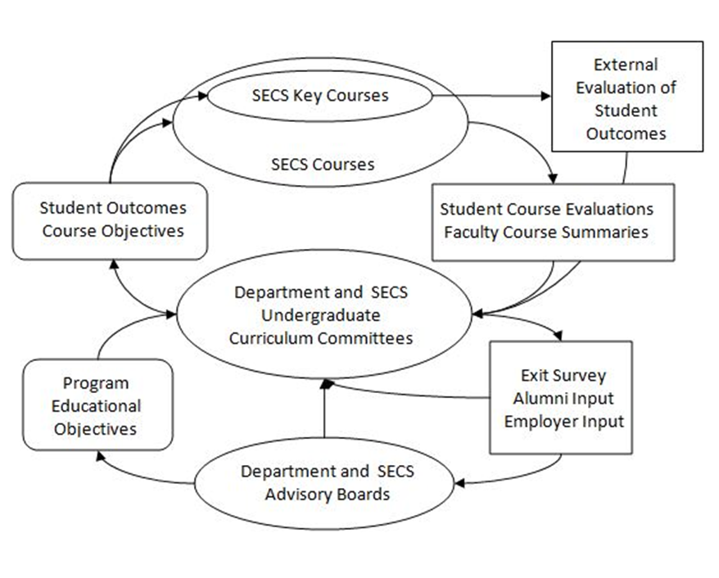
OU SECS Assessment and Continuous Improvement

Slide 33
Recent OU ABET History
Started to plan in 2000, first review in 2002
Many mistakes made
  Significant faculty resistance
  SECS (not ABET) Program (Student) Outcomes
  Far too much data accumulated
  Far too little evaluation and feedback
  2-year visits required for 6 years
Unexpected results
  Senior design experience – multidisciplinary teams, gaps in skills
  Core engineering curriculum – restructured, more multidisciplinary
2008, 2014 reviews – 6-year accreditations
Next general review – 2020
  Revisit structure of core engineering curriculum
  Always seeking ways to reduce data taken, streamline system
  Always need to track changes in ABET criteria

